Slide 1
Reconfigurable Computing
Introduction

Slide 2
Computing Paradigms
Processing architectures:
General-purpose processors
The Von Neumann Computer
Domain-specific processors
for a class of applications (e.g. multimedia, DSP)
Application-specific processors
for one application
Reconfigurable processors

Slide 3
The Von Neumann Computer
Principle
In 1945, the mathematician Von Neumann (VN):
A computer could have a simple structure,
capable of executing any kind of program,
given a properly programmed control unit,
without the need of hardware modification.

Slide 4
The Von Neumann Computer
Structure
A memory for storing program and data and instructions.
A control unit (control path) featuring a program counter for controlling program execution
An ALU for program execution
Processor or
Central processing unit
Memory
Datapath
Data
and
Instructions
Data
Registers
Control path
Address
register
Instruction
register
PC
Address

Slide 5
The Von Neumann Computer
Coding
A program is coded as a set of instructions to be
sequentially executed
Program execution
Instruction Fetch (IF): The next instruction to be executed is fetched from the memory
Decode (D): The instruction is decoded to determine the operation
Read operand (R): The operands are read from the memory
Execute (EX): The required operation is executed on the ALU
Write result (W): The result of the operation is written back to the memory
Instruction execution in Cycle (IF, D, R, EX, W)

Slide 6
The Von Neumann Computer
Advantage:
Flexibility: any well coded program can be executed
Drawbacks:
Speed efficiency: Not efficient, due to the sequential program execution
They cannot even drive their display (need graphics accelerator)
Resource efficiency: Only one part of the hardware resources is required for the execution of an instruction. The rest remains idle
Memory access: Memories are about 10 time slower than the processor
Energy efficiency: MOPS/W
Speed drawbacks are compensated using high clock speed, pipelining, caches, instruction pre-fetching, etc.

Slide 7
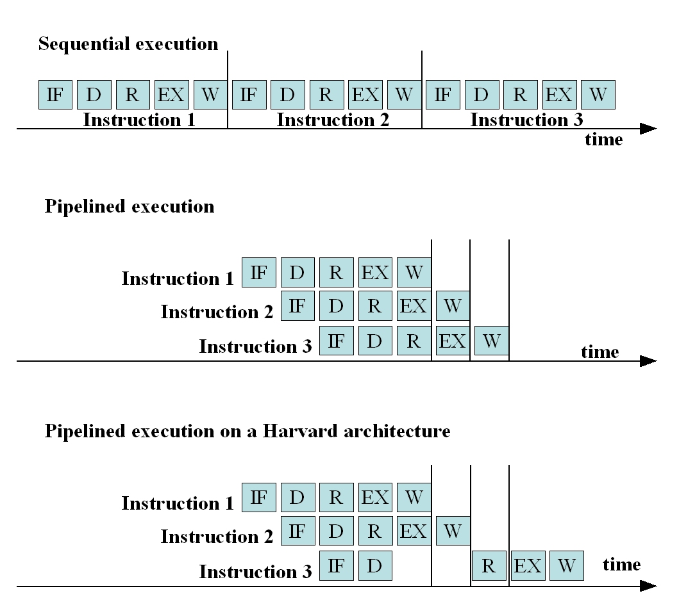
The Von Neumann Computer
Sequential execution
t_{cycle} = cycle execution time
One instruction needs t_{instruction} = 5*t_{cycle}
3 instructions: in 15*t_{cycle}
Pipelining:
One instruction needs t_{instruction} = 5*t_{cycle}
no improvement
3 instructions: in 7*t_{cycle} in the
ideal case.
→ Increased throughput
Even with pipeline, cache, etc., execution remains sequential.

Slide 8
Multi-Core/Many-Core
Goal:
Using parallelism in the VN computer.
Characteristics:
Applicable to applications with parallel algorithms
Memory access still limited (techniques: local memory, shared memory, …)
Limited speedup

Slide 9
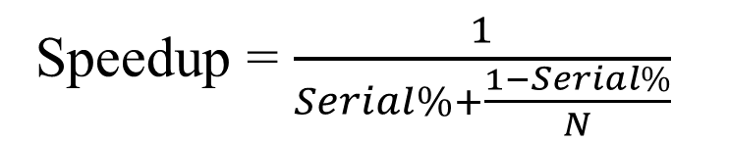
Multi-Core/Many-Core Speedup
Amdahl’s Law:
Speedup = $\frac{1}{Serial\%+\frac{1−Serial\%}{N}}$
Serial% = 6.7%
N = 16 Cores, Speedup = 8
Serial% = 20%
N = 6 Cores,
Speedup = 3

Slide 10
Multi-Core Speedup
Amdahl’s Law:
Speedup by multi-cores is limited.
Even when the number of cores is large, it is limited by the serial part:
If 88% of the operations are not parallelizable, (regardless of the number of cores):
Max speedup = 1/(0.88) = 1.136 !
To achieve 50x speedup, at least 98% of the application must be appropriate for substantial acceleration.

Slide 11
Domain-Specific Processors
Goal:
Overcome part of the drawbacks of the VN computer.
Characteristics:
Optimized datapath for a given class of applications
Example: DSP
Applications usually multiply accumulate (MAC)-dominated:
A ← A + (B * C)
Datapath optimized to execute one or many MACs in only one cycle.
Instruction fetching/decoding overhead removed for some operations
Fewer memory access
Special support for efficient looping
Special loop or repeat instruction

Slide 12
MAC on a VN Machine
Fetch MUL
Decode MUL
Read operand
Multiply
Store result (B*C)
Fetch ADD
Decode ADD
Read the stored result (B*C)
Add with the accumulated value (A + B*C)
Store

Slide 13
Loops on a VN Machine
Instruction cycles (fetch, decode, …) for:
Updating loop counter
Testing loop counter
Jumping back to the top of the loop

Slide 14
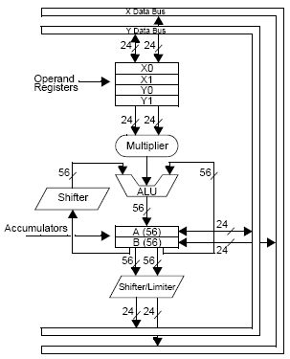
Domain-specific processors
The hardware contains:
One or more MAC-Units
Multi-ported on-chip and off-chip memories
Multiple on-chip busses
Address generation unit supporting addressing modes tailored for DSP-applications

Slide 15
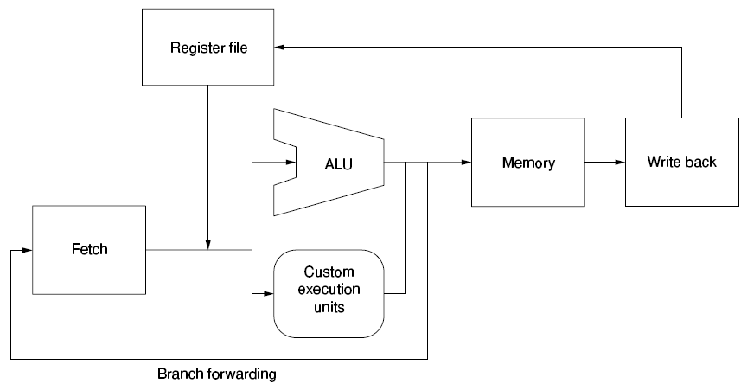
ASIP
Application-Specific Instruction Set Processors:
Instruction set is customized to a specific domain/application
DSP, neural networks, …
Can be classified as domain-specific
Xtensa from Tensilica (Acquired by Cadence in 2013)
A processor core which lets the system designer:
select and size features for a given application
define new instructions.

Slide 16
Application-Specific Processors
Optimize the complete circuit for a specific function
DSPs have VN architecture.
with a degree of application-specific features
Example: ASIC: Application-Specific Integrated Circuit.
Optimization is done by implementing the inherent parallel structure on a chip
The data path is optimized for only one application.
Instruction fetching and decoding overhead is removed
Memory access is limited:
Directly processing the input data flow

Slide 17
Application-Specific Processors
ASIC implementation:
Complete execution in
parallel in one clock cycle
run-time = t_{clock}= delay of longest path from input to output
ASIC Example:
Implementation of a VN computer:
if (a < b) then
{
d = a+b;
c = a*b;
}
else
{
d = a+1;
c = b-1;
}
At least 3 instructions
run-time >= 3*t_{instruction}

Slide 18
ASIC as Accelerator
ASIC as a coprocessor

Slide 19
ASIC as Accelerator
High manufacturing cost

Slide 20
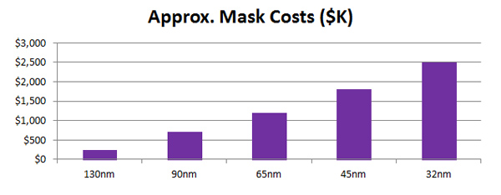
ASIC as Accelerator
High manufacturing cost

Slide 21
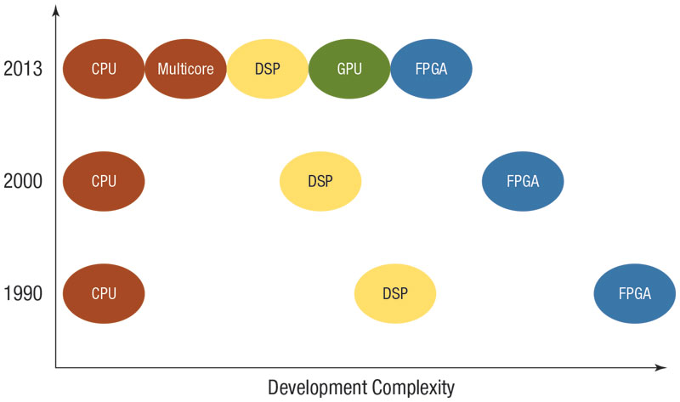
Development Complexity
[Peckham13]

Slide 22
Conclusion
Von Neumann computer:
General purpose, used for any kind of function
DSPs
Designed for a class of applications
ASICs
Tailored for one application

Slide 23
Conclusion
Von Neumann computer:
General purpose, used for any kind of function
High degree of flexibility
Speed and energy efficiency problem
Some restrictions on the program coding and execution scheme
Programs have to adapt to the machine
DSPs
Designed for a class of applications
Flexibility and efficiency only for a given class of applications
ASICs
Tailored for one application
Very efficient in speed and resource
Hardware adapts to the application
Cannot re-adapt to a new application
Not flexible

Slide 24
Reconfigurable Computing
The ideal device should combine:
Flexibility of the VN computers
Efficiency of ASICs
The ideal device should be able to
Optimally implement an application in acceptable time
Re-adapt to allow the optimal implementation of a new application
We call such a device a reconfigurable device.

Slide 25
Reconfigurable Computing
The ideal device should combine:
Flexibility of the VN computers
Efficiency of ASICs
The ideal device should be able to
Optimally implement an application in acceptable time
Re-adapt to allow the optimal implementation of a new application
We call such a device a reconfigurable device.
Definition: Reconfigurable computing: study of computations involving reconfigurable devices.
Architectures
Algorithms
Applications

Slide 26
RCS Definitions
“Reconfigurable computing refers to any information processing system in which blocks of hardware can be reorganized or repurposed to adapt to changing dataflows or algorithms.”
Ron Wilson, EE Times
“A reconfigurable computer is a device which computes by using post-fabrication spatial connections of computable elements.”
Andre DeHon
“Reconfigurable devices contain an array of computational elements whose functionality is determined through multiple programmable configurations.”
Compton and Hauck
“On-the-fly ASIC”
Kurdahi
“Soft hardware”
Lyke
All are correct:
Better to understand by example

Slide 27
Main Idea
Benefits:
Lower cost
Extensibility
[Lyke15]

Slide 28
Reconfigurable Computing
Configuration:
A device is configured when its functionality is set.
ASIC is configured when the circuit is fabricated.
Gate arrays/structured ASIC are configured when the routing is defined.
Structured ASIC: ASICs that may be repurposed with a single mask layer (or a few) instead of several dozen
Intel eASIC N5X
Microprocessor is configured when an instruction is read from memory.
→ Microprocessors bind functionality at every cycle.

Slide 29
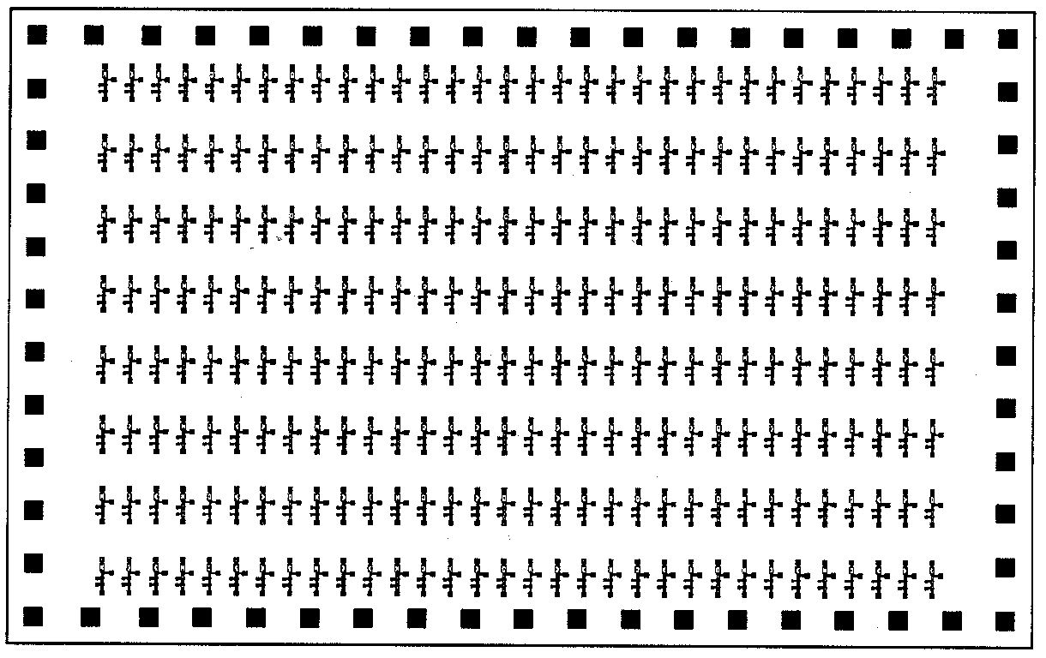
Uncommitted Gate Array

Slide 30
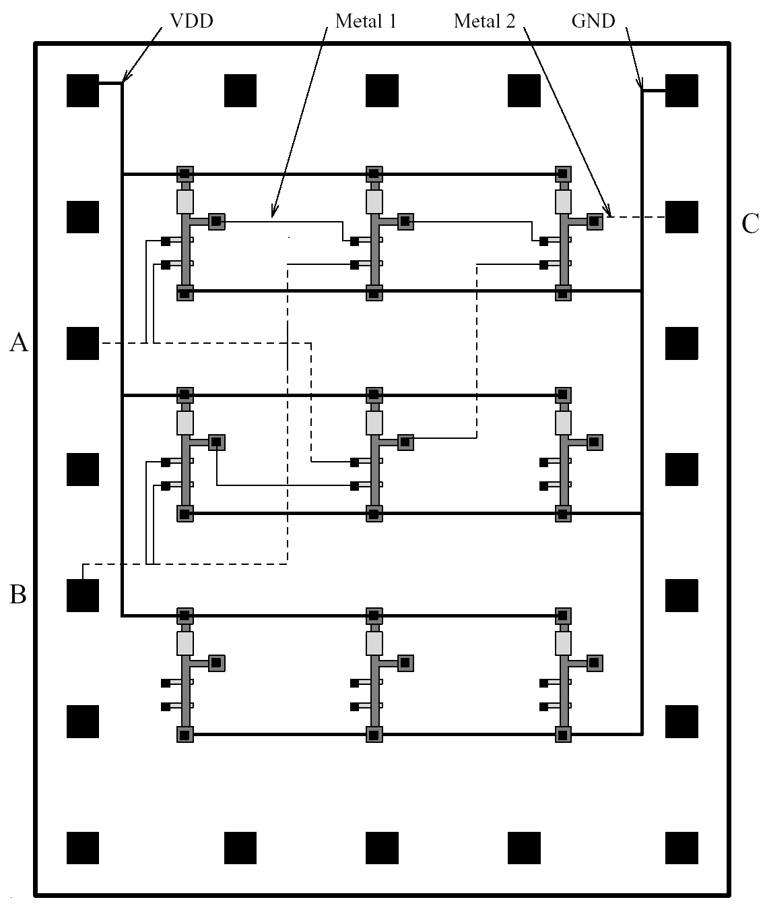
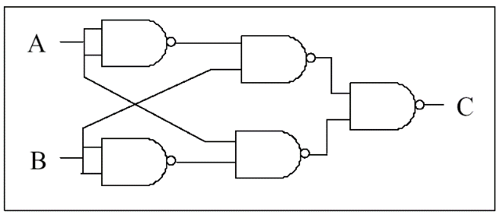
Committed Gate Array

Slide 31
Reconfigurable Computing
Configuration:
The amount of programmability:
ASIC: can perform exactly one task (not programmable)
GPP: can perform a wide variety of operations:
ISA defines the number of operations that can be performed at a given time.
64 bits
FPGA: functionality is dedicated by bitstream:
10 - >1000 million bits
Virtex-II Pro XC2VP125: 43 million bits, Virtex-7: 112 million bits, Virtex UltraScale+: 1024 million bits)

Slide 32
Reconfigurable Computing
Reconfigurabilty:
The ability to continually change the functionality of the device.
But microprocessors are not usually considered as reconfigurable devices.
Reconfiguration:
The process of changing the structure of a reconfigurable device (at run-time or off-line)

Slide 33
Flexibility vs Efficiency
y
t
i
l
i
Von Neumann
b
i
x
DSP
e
General purpose
l
F
computing
Domain-specific
computing
Reconfigurable
systems
Reconfigurable
computing
ASIC
Application
-specific
computing
Perfromance

Slide 34
A Decade of Progress
200x More Logic
Plus memory, μP etc.
40x Faster
50x Lower Power
500x Lower Cost
1000x
XC4000 &
Virtex-4
Spartan
100x
CLB Capacity
Virtex-II &
Speed
Virtex-II Pro
Power per MHz
Virtex &
[Areiba08]
Price
Virtex-E
10x
Spartan-2
XC4000
Spartan-3
1x
'91 '92 '93 '94 '95 '96 '97 '98 '99 '00 '01 '02 '03 '04
Year
Courtesy: Richard Sevcik, Xilinx

Slide 35
Three Decades of Progress
Capacity:
logic cell count
10,000x
Speed:
same-function performance in programmable fabric.
100x
Price:
per logic cell
1000x
Power:
per logic cell
1000x
[Trimberger18]

Slide 36
High performance parallel computing
Traditional parallel implementation flow
1
Application
2
3
1
2
3
4
4
5
6
7
Virtual Topology
Physical Topology
Exploiting reconfigurable topology
Application
1
1
2
3
2
3
4
5
6
7
4
5
6
7
Physical Topology
Virtual Topology

Slide 37
The main question
A reconfigurable device is a piece of hardware and
A hardware can never change after fabrication
Then
How is a reconfigurable device made?

Slide 38
Microprocessor-Based Systems (Temporal)
Data Storage
(Register File)
A
B
C
ALU
64
Generalized to perform many functions well
Operates on fixed data sizes.
Inherently sequential
Constrained even with multiple data paths.

Slide 39
A Simple Reconfigurable Circuit
if (A > B) {
H = A;
L = B;
}
else {
H = B;
L = A;
}
A
B
Functional
Unit
H
L
Functional unit optimized to perform a special task.

Slide 40
Example: Bubblesort (Spacial)
A
B
A
B
H
L
H
L
A
B
A
B
H
L
H
L
A
B
H
L
Highest Value
Lowest Value
Adapt interconnect to problem.
Take advantage of parallelism.

Slide 41
ASIC as Accelerator
Increasing design cost + manufacturing cost
Decreasing life cycle
→ Decreasing number of wafer starts

Slide 42
ASIC Starts vs. FPGA Starts

Slide 43
More Life Cycle in FPGAs

Slide 44
FPGA Replacing ASIC
rDPA:
Reconfigurable Data Path Array

Slide 45
Conclusion
[www.altera.com]
ASSP:
Application-Specific Standard Parts:
As ASIC but more general-purpose device (for many system design houses.
Examples:
Interface chips (USB, …)

Slide 46
Cost-Volume Curve
Cost
PLD
ASIC
Cross-over volume
Volume
Increasing manufacturing costs increases NRE costs
→ Crossover point shifts to right with every new technology node.

Slide 47
Cost-Volume Curve
Cost
PLD
ASIC
Cross-over volume
Volume
→ For many users, ASIC is not a choice anymore.
→ ASIC for very high volume or very high performance (millions of units [Trimberger18])
Few chips: cryptocurrency miners, image processing chips for TVs

Slide 48
Speedups
Reported speedups:
Up to x28500
[Cardoso11]

Slide 49
Speedups
SR: Super-Resolution:
Construction of high-resolution images from several low-resolution observations
Speedup: up to 4 orders of magnitude
[Georgis16]

Slide 50
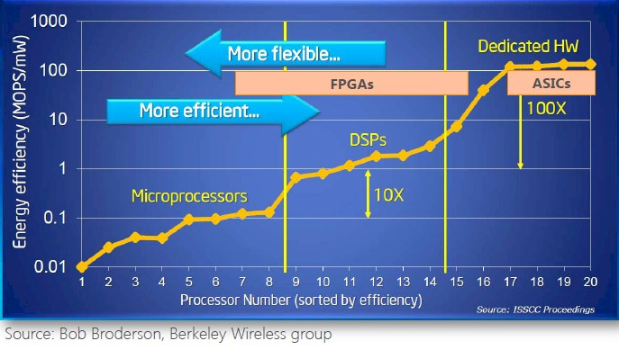
Efficiency
[ExtremeTech16]

Slide 51
Efficiency

Slide 52
Spiking Neural Neworks
[Isik23]

Slide 53
References
[Areiba08] Areiba, “Reconfigurable Computing Systems,” Lecture Slides.
[Bobda07] Bobda, Reconfigurable Computing Systems,” Lecture Slides.
[Cardoso11] Cardoso and Hubner, Reconfigurable Computing: From FPGAs to Hardware/Software Codesign, Springer, 2011.
[Peckham13] Clarence Peckham, “GPGPUs Stake Out Territory beside FPGAs for Military Signal Processing,” COTS Journal, April 2013.
[Georgis16] Georgis, Georgios, George Lentaris, and Dionysios Reisis. "Acceleration techniques and evaluation on multi-core CPU, GPU and FPGA for image processing and super-resolution." Journal of Real-Time Image Processing (2016): 1-28.
[ExtermeTech16] Joel Hruska, “Intel launches Stratix 10: Altera FPGA combined with ARM CPU, 14nm manufacturing,” ExtremeTech, 2016.

Slide 54
References
[Kaeli15] Kaeli, et al, Heterogeneous Computing with OpenCL 2.0, Morgan Kaufmann, 2015.
[Lyke15] Lyk, et al, “An Introduction to Reconfigurable Systems,”, Proceedings of the IEEE, Vol. 103, No. 3, March 2015.
[Trimberger18] Trimberger, Three Ages of FPGAs: A Retrospective on the First Thirty Years of FPGA Technology, IEEE Solid-State Circuits Magazine 10.2 (2018): 16-29.
[Isik23] Isik, “A Survey of Spiking Neural Network Accelerator on FPGA,” arXiv preprint arXiv:2307.03910, (2023).

